Slide 1
Hotel Rating Classification
Created by :
1.Indrani
2.Maheswari
3.Himanshu patil
4.Siri
5.Rohit
6.Nidhi
7.Dhiraj

Slide 2
Context
Business Problem Understanding
Business Objective
EDA Visualization

Slide 3
Business problem understanding
The classifications are: Tourist (★) | Standard (★★) | Comfort (★★★) | First Class (★★★★) | Luxury (★★★★★)
From the initial purpose of informing travellers on basic facilities that can be expected, the objectives of hotel rating have expanded into a focus on the hotel experience as a whole.

Slide 4
Business objective
To understand the dataset and what the customers are looking online when booking a hotel
Hotel ratings are often used to classify hotels according to their quality.

Slide 5
EDA Visualization

Slide 6
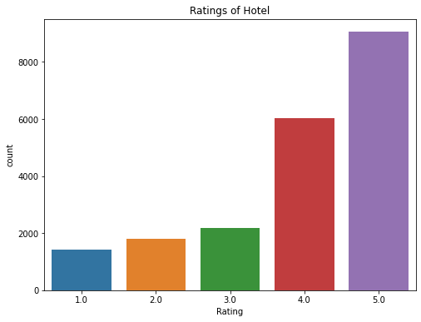
Ratings of Hotel
The hotel is working efficiently on its own.
More than half of the customers had given a positive feedback.
We will try to figure out the problems with 1,2,3 star ratings.

Slide 7
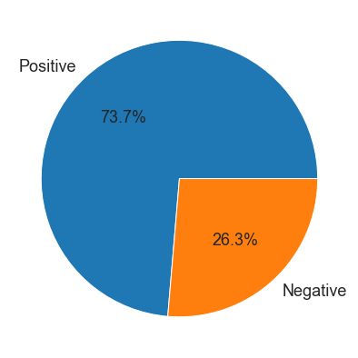
REVIEWS
The rating between1-3 are considered as negative ratings which comprises of around 26.3% as per the dataset given.
The rating 4&5 are considered as positive ratings which comprises of around 73.7% as per the dataset given.

Slide 8
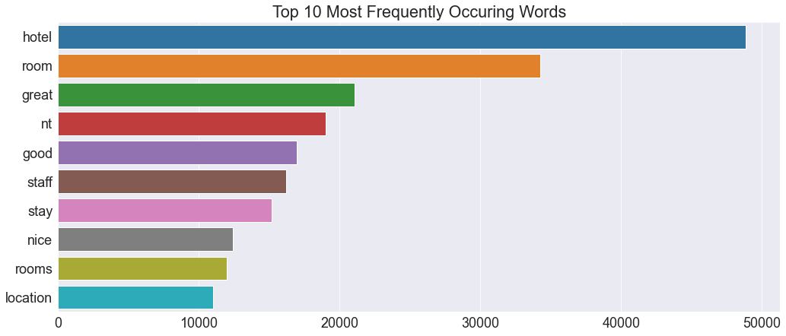
Frequently Occurring Phrases

Slide 9
Word Cloud
Word cloud for 1 star
Word cloud for 2 star
Word cloud for 3 star
Word cloud for 4 star
Word cloud for 5 star

Slide 10
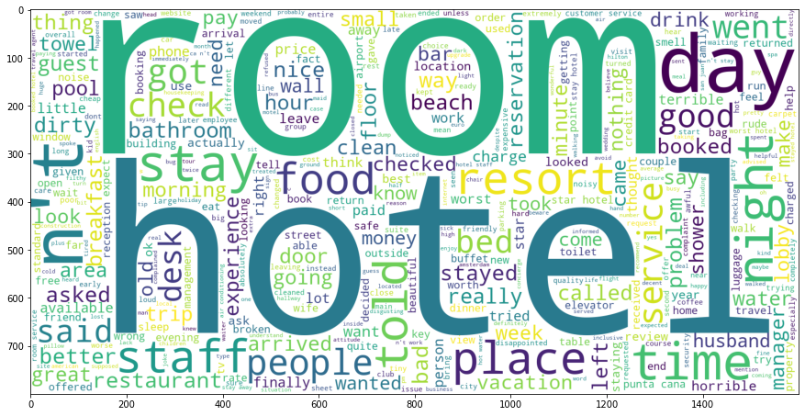
Word Cloud for 1 Star Rating

Slide 11
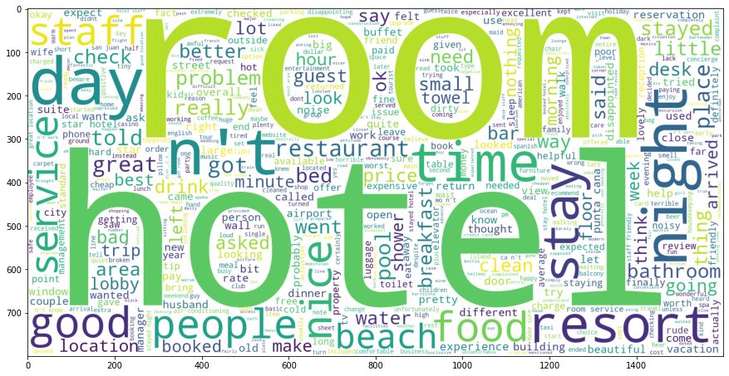
Word cloud for 2 Star Rating

Slide 12
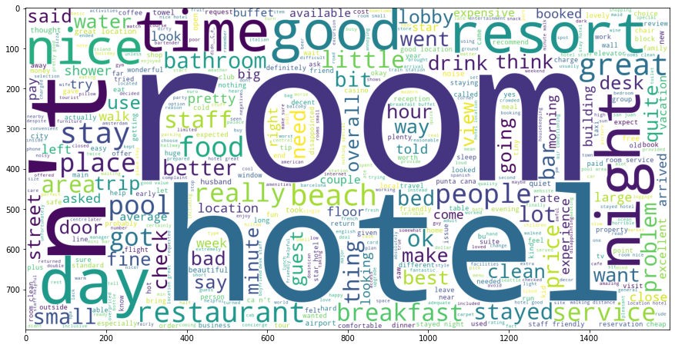
Word Cloud for 3 Star Rating

Slide 13
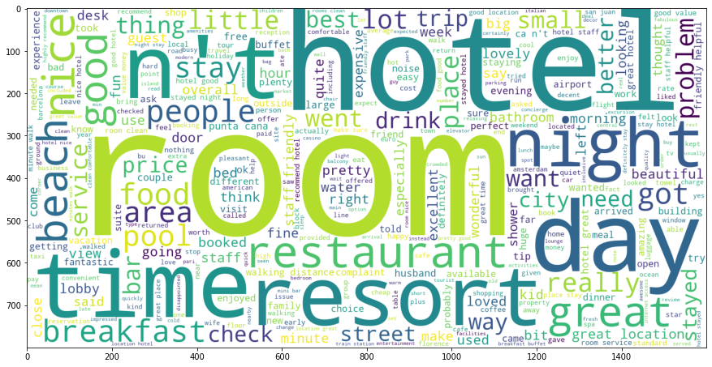
Word Cloud for 4 Star Rating

Slide 14
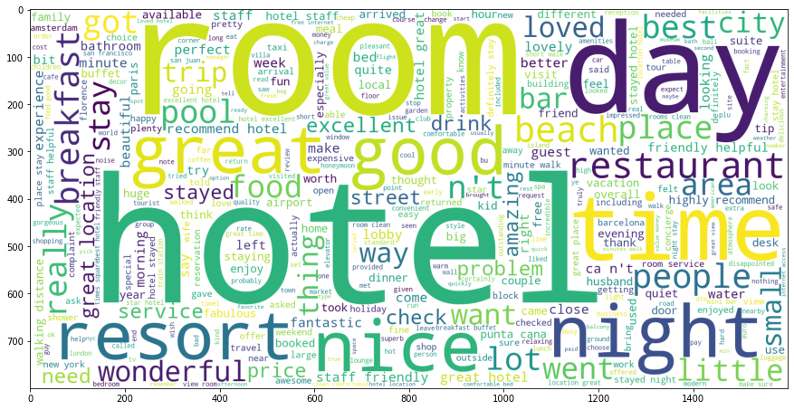
Word Cloud for 5 Star Rating

Slide 15
Model Building
Model | Accuracy
Logistic Regression | 92.23111458130002%
XGBoost | 90.02537575639273%
Light GBM | 92.5434315830568%
MLP Classifier | 92.5629513956666%
Random Forest | 89.42026156548897%

Slide 16
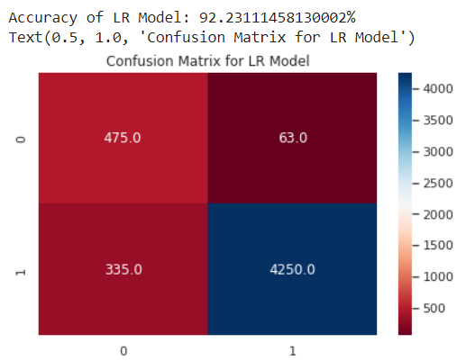
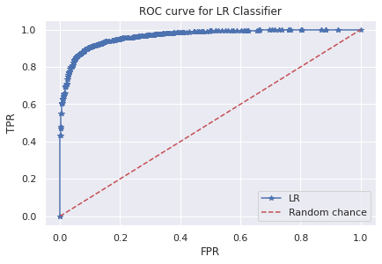
Logistic Regression

Slide 17
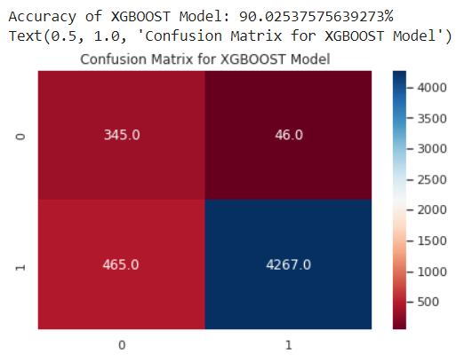
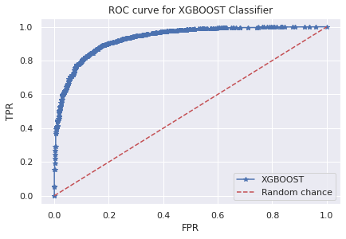
XGBoost

Slide 18
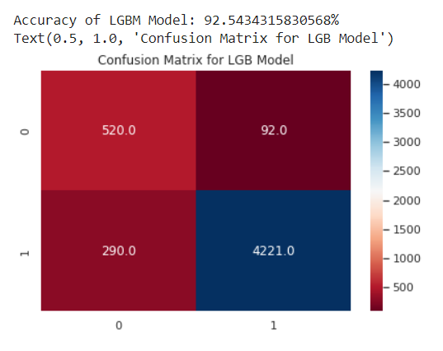
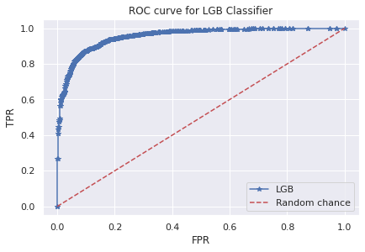
Light GBM

Slide 19
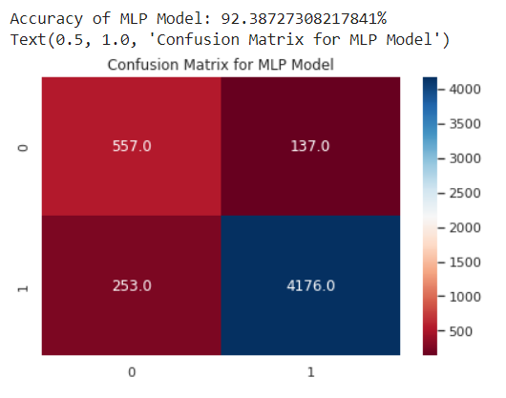
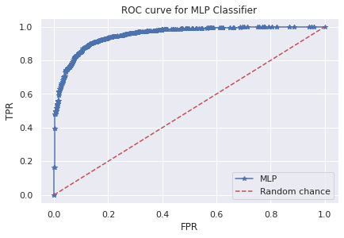
MLP Classifier

Slide 20
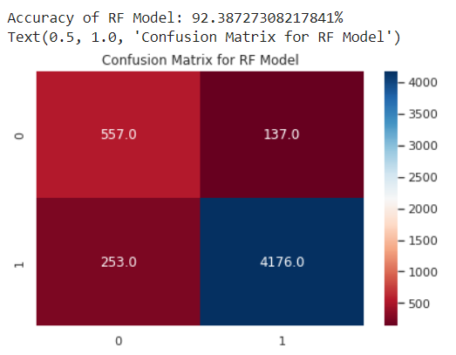
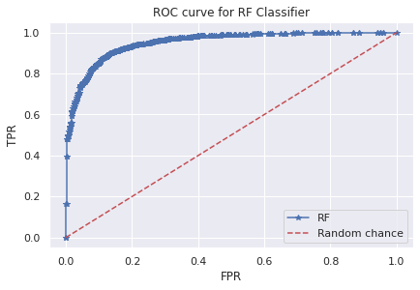
Random Forest

Slide 21
Model Deployment
In this project we are deploying the model using pickle and streamlit

Slide 22
Streamlit
We are using Streamlit to deploy the model
Using pickle we dump the model in a pkl file
We created the architecture of the web Application using Streamlit methods
We initialized a variable ‘date’ where the user will give the date values
We load the same model using it’s pickle file
We feed the date value to the model and print the prediction

Slide 23
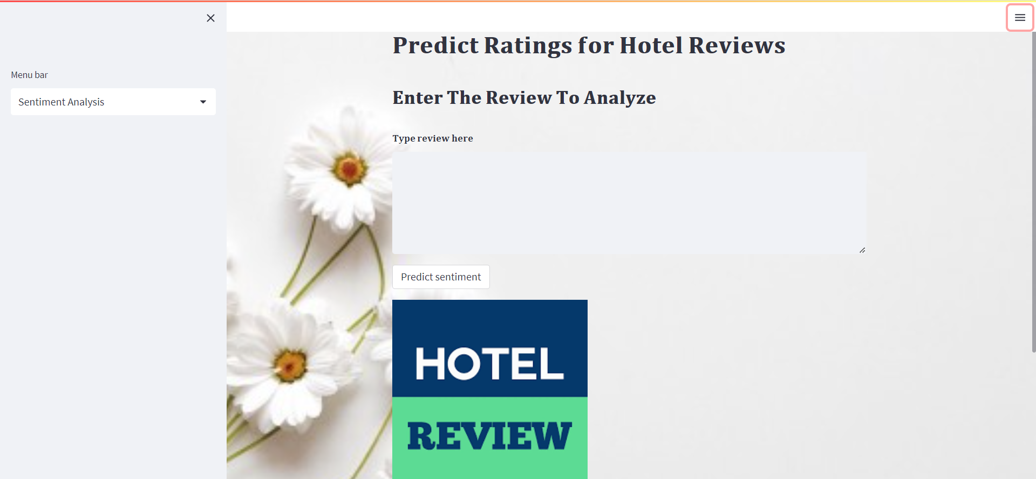
Web Interface

Slide 24
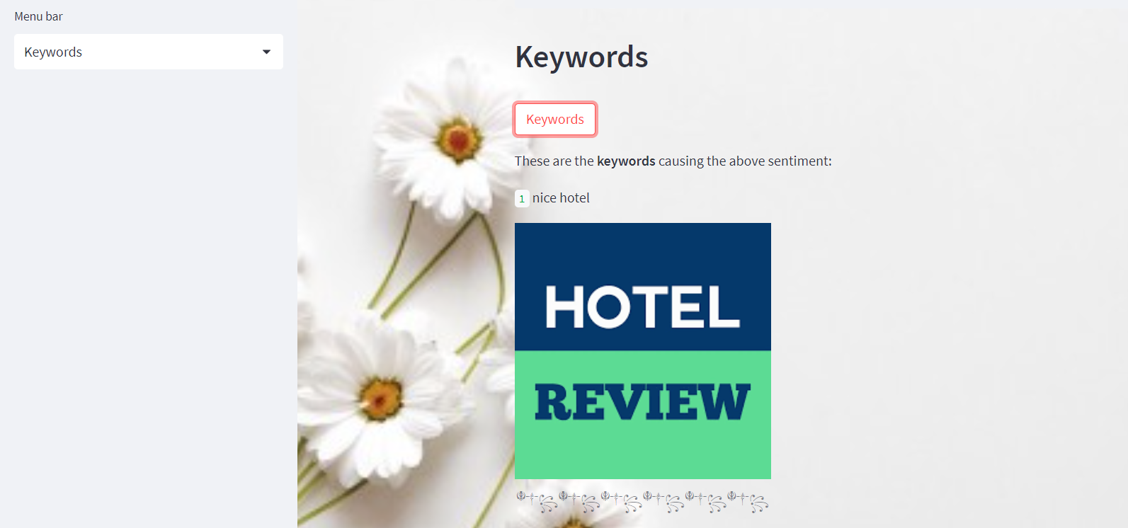
Keywords Web Interface

Slide 25
Thank You
Group members name

